Slide 1

Introduction to Operating Systems CS/COE 1550
Summer 2020-2021
Sherif Khattab
ksm73@pitt.edu
(Some slides are from Silberschatz, Galvin and Gagne ©2013)

Slide 2
Announcements
Upcoming deadlines:
Homework 3: due on 6/11
Tophat questions due one week after each lecture
Project 1: due on 6/14
VS Code
Please exit from qemu using CTRL+a then x

Slide 3
Last Lecture …
Monitors
Usage
Implementation
Other synchronization mechanisms
Semaphore solution for the Bounded Buffer problem

Slide 4
Muddiest Points
Mesa vs Hoare semantics and situations where one would be used over the other
code location of the condition variables
condition variable implementation
process synchronization mechanism in monitors
lock and condition variable implementations
Just need to go over monitors and its different semantics
for message passing, the messaging queue is just a queue of messages waiting to be sent out right? It isn't a queue of messages that have already been sent or messages that still need to be read?
Not a question: just need to take a second pass on implementing conditions with Hoare on my own to let it sink in. The explanation itself was good, matching the drawing with the code is ideal.
When implementing locks + condition variables, does the semCount variable keep track of the number of waiting process for the entire queue or is it per condition variable?

Slide 5
Muddiest Points (1/3)
Mesa and Hoare
When are Mesa vs. Hoare semantics used?
Process communication within monitors
The process of cond vars with P and Q and signalling and waiting
Why exactly if vs while determines if the signaling process waits or proceeds
Why Hoare is better than Mesa
Monitors vs semaphores
The usefulness of condvars

Slide 6
Muddiest Points (2/3)
implementing condition variables and the locks
will we ever have to implement a monitor?
How down and up work in the diagram for implementing locks with semaphore
The different queues in the lock diagram
Monitors:
can you have multiple “copies” of a synchronized method or class so that only a max number of processes can run it at a time (specifically in java)
what's the difference between signal() and wakeup(), what is conditionVariable queue, how condition variable works, feel lost in Sahara with both the recording and the picture on the screen
Is it possible for monitors to have multiple condition variables which would allow for more than one process to be inside of a class/monitor at a given time?
What does it mean that signals on condition variables aren't "saved up"?
How processes enter and exit monitors

Slide 7
Muddiest Points (3/3)
Project 1:
How to start this project
How to implement PCB list in the semaphore
Message Passing
How are multiple channels managed in message passing?
What exactly a barrier is and how it relates to message processing
i think i just need a better foundational understanding of what spinlocks/semaphores/monitors are because i'm extremely lost when looking at details

Slide 8
Today’s Agenda …
Classical Process Synchronization Problems
Bounded Buffer
Readers-Writers
Dining Philosophers
Sleepy Barber

Slide 9
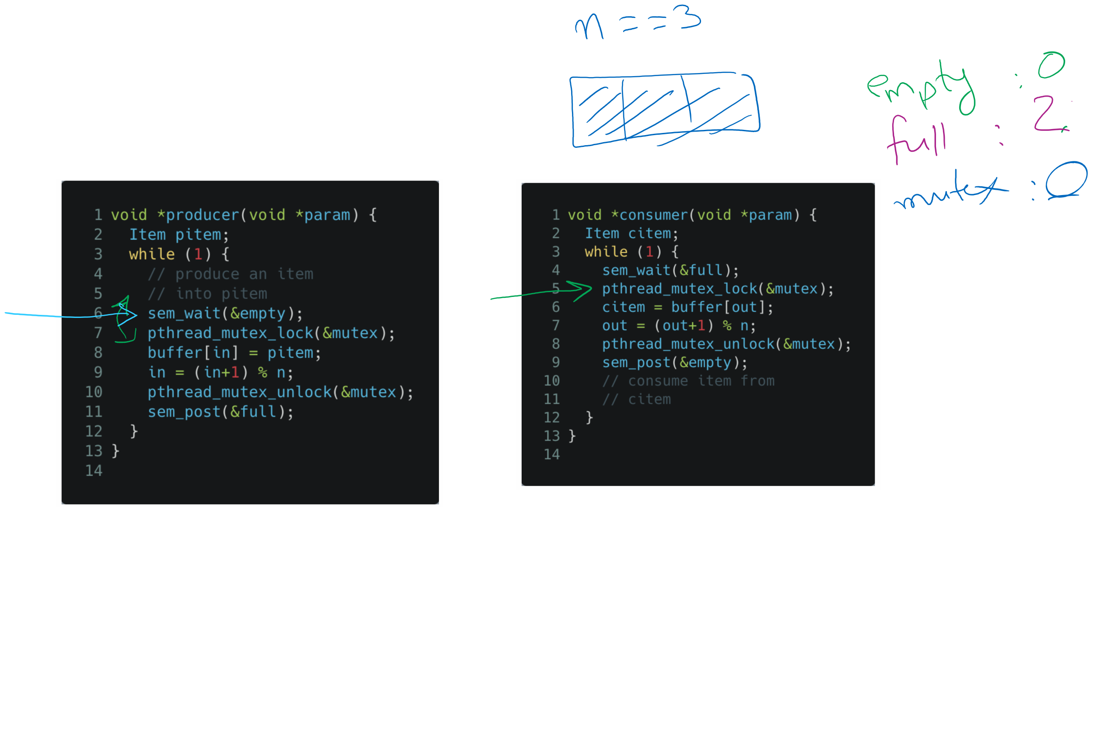
Tracing the solution

Slide 10
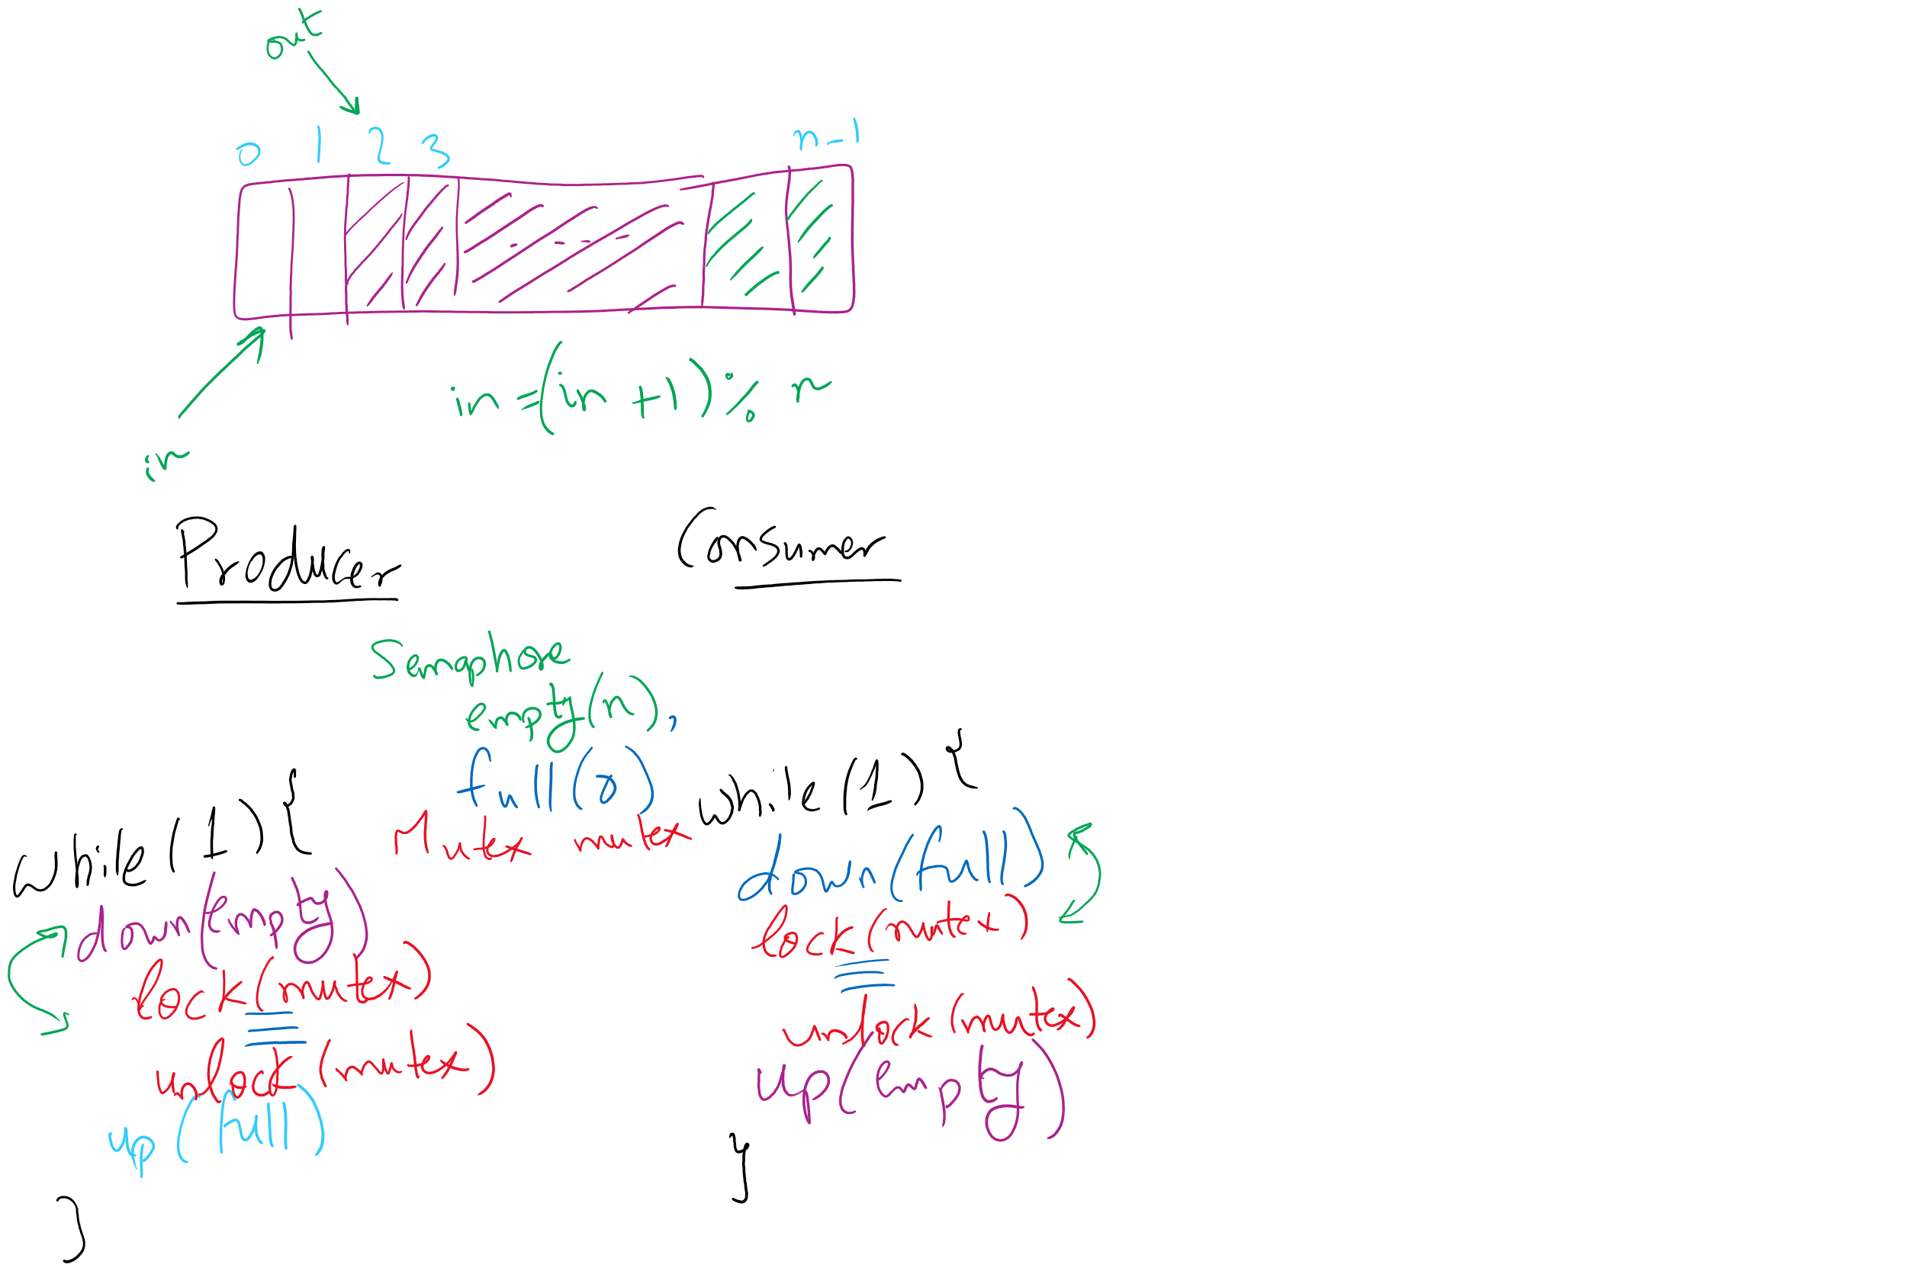
Bounded Buffer (Another rundown)

Slide 11
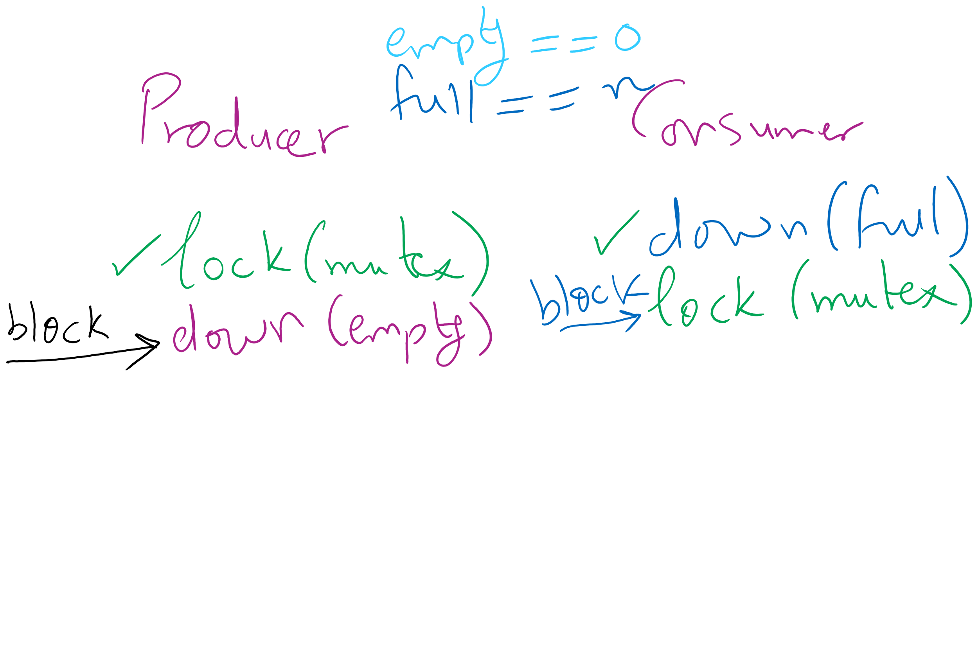
Deadlock can happen with a small mistake

Slide 12
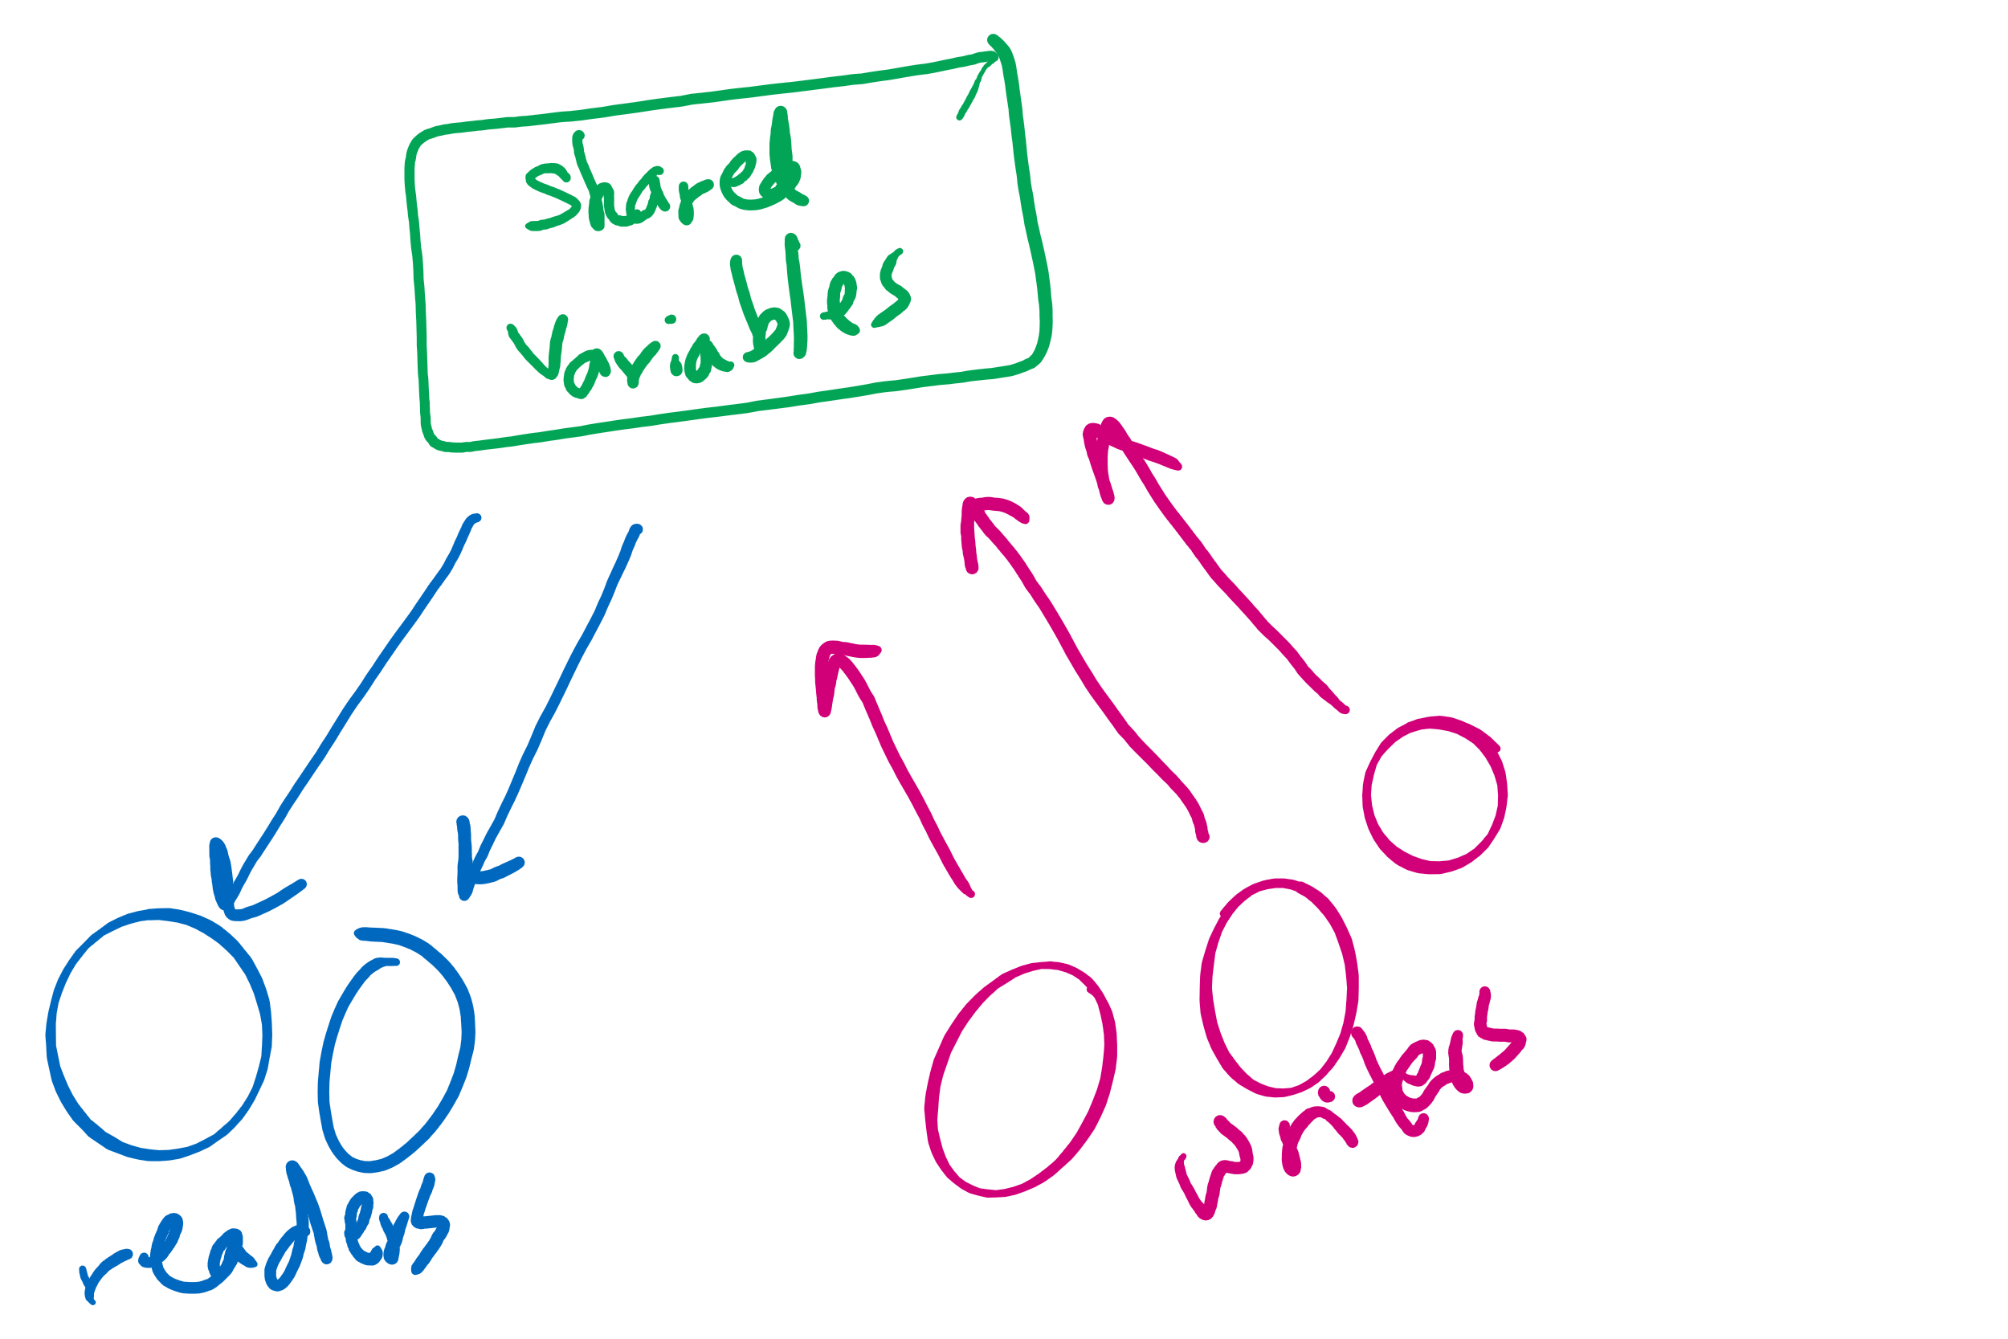
Readers-writers problem
Shared variables
int nreaders;
Semaphore mutex(1), writing(1);
Reader process
…
mutex.down();
nreaders += 1;
if (nreaders == 1) // wait if
writing.down(); // 1st reader
mutex.up();
// Read some stuff
mutex.down();
nreaders -= 1;
if (nreaders == 0) // signal if
writing.up(); // last reader
mutex.up();
…
Writer process
…
writing.down();
// Write some stuff
writing.up();
…

Slide 13
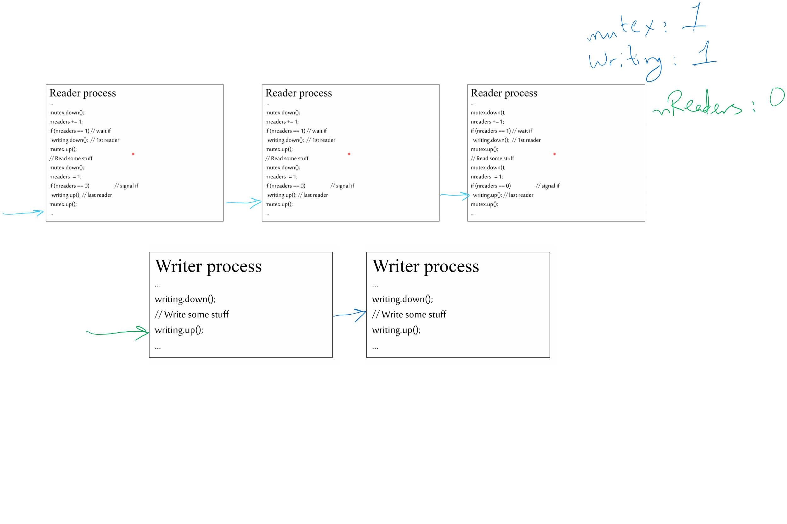
Tracing the solution

Slide 14
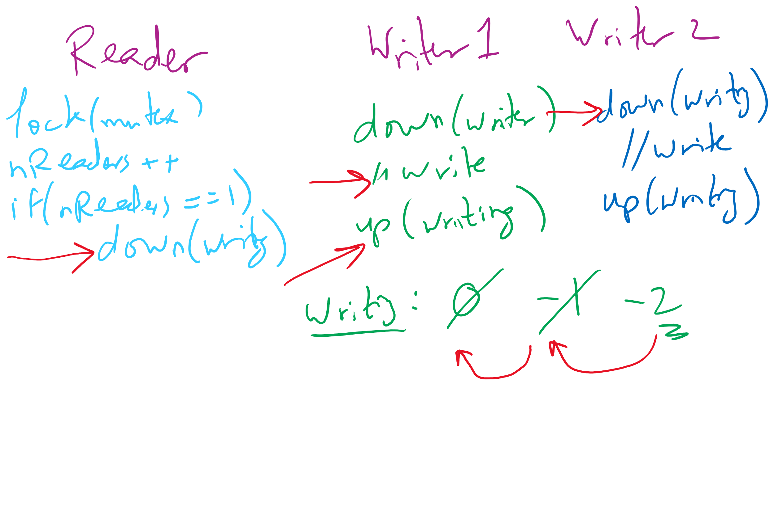
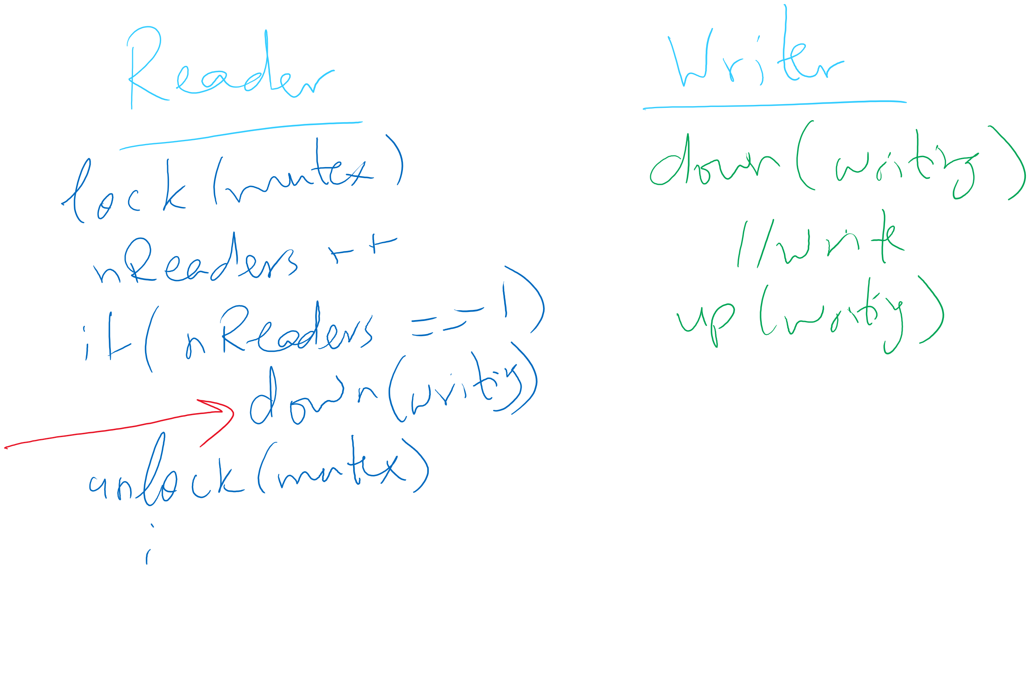
Readers Writers Scenarios

Slide 15


Dining Philosophers
N philosophers around a table
All are hungry
All like to think
N chopsticks available
1 between each pair of philosophers
Philosophers need two chopsticks to eat
Philosophers alternate between eating and thinking
Goal: coordinate use of chopsticks

Slide 16
Dining Philosophers: solution 1
Use a semaphore for each chopstick
A hungry philosopher
Gets the chopstick to his right
Gets the chopstick to his left
Eats
Puts down the chopsticks
Potential problems?
Deadlock
Fairness
Shared variables
const int n;
// initialize to 1
Semaphore chopstick[n];
Code for philosopher i
while(1) {
chopstick[i].down();
chopstick[(i+1)%n].down();
// eat
chopstick[i].up();
chopstick[(i+1)%n].up();
// think
}

Slide 17
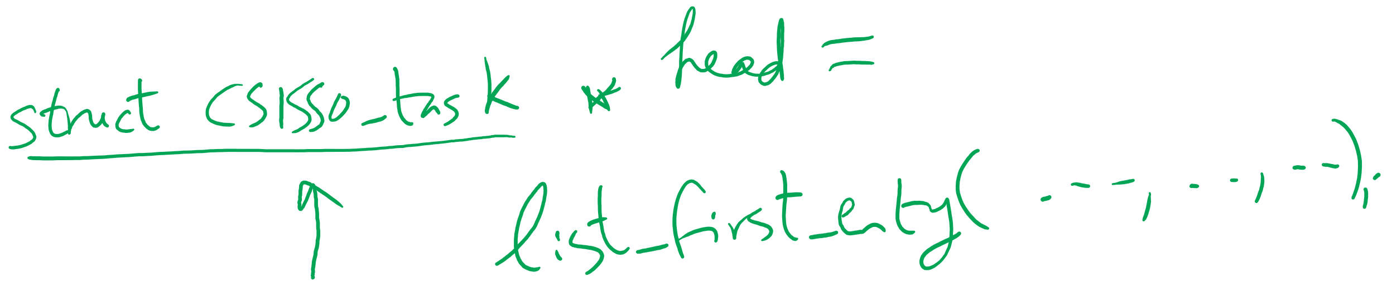
Project 1: Getting the first entry in a list_head linked list

Slide 18
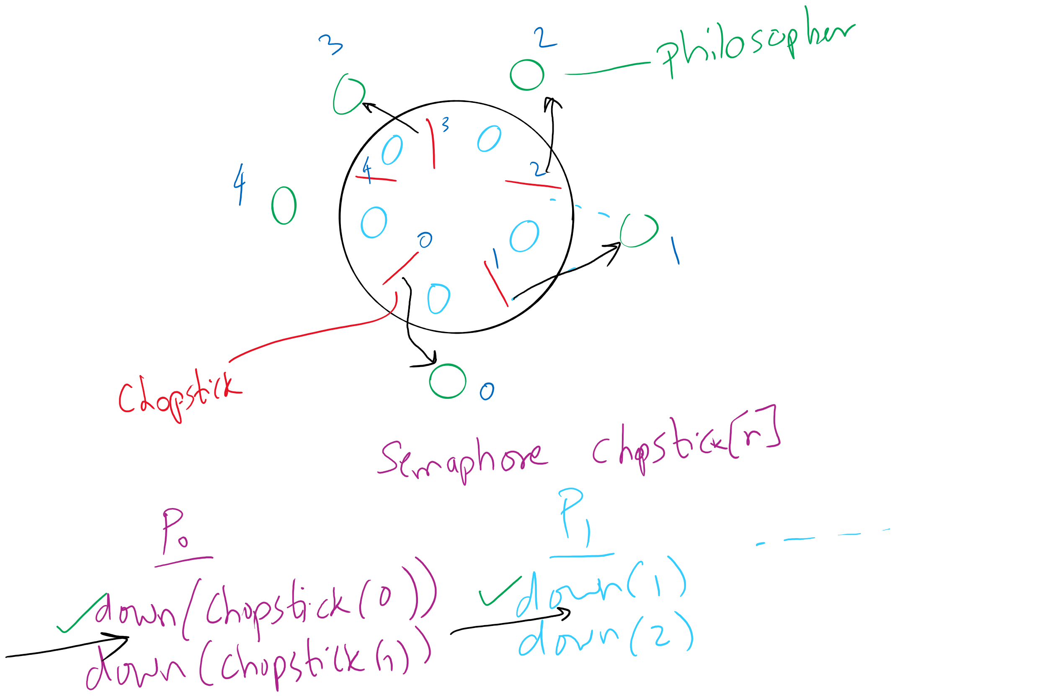
Deadlock in the first (incorrect) solution of Dining Philosophers

Slide 19
Dining Philosophers: solution 2
Use a semaphore for each chopstick
A hungry philosopher
Gets lower, then higher numbered chopstick
Eats
Puts down the chopsticks
Potential problems?
Deadlock
Fairness
Code for philosopher i
int i1,i2;
while(1) {
if (i != (n-1)) {
i1 = i;
i2 = i+1;
} else {
i1 = 0;
i2 = n-1;
}
chopstick[i1].down();
chopstick[i2].down();
// eat
chopstick[i1].up();
chopstick[i2].up();
// think
}
Shared variables
const int n;
// initialize to 1
Semaphore chopstick[n];

Slide 20
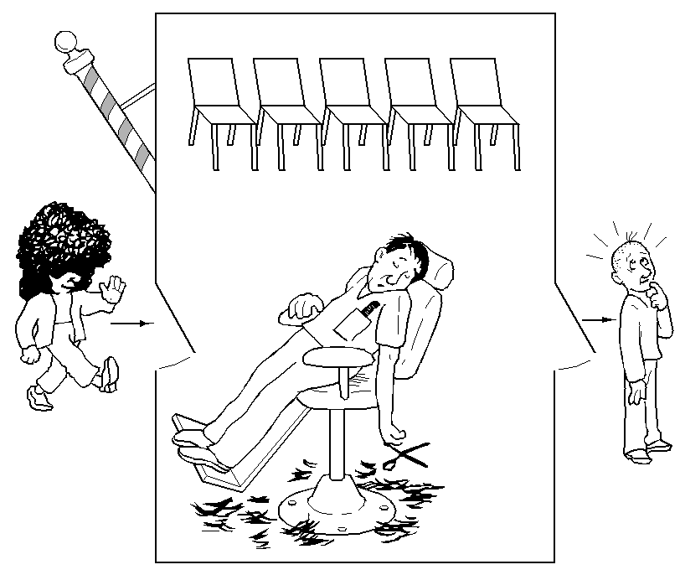
The Sleepy Barber Problem

Slide 21
Code for the Sleepy Barber Problem
#define CHAIRS 5
Semaphore customers=0;
Semaphore barbers=0;
Semaphore mutex=1;
int waiting=0;
void barber(void)
{
while(TRUE) {
// Sleep if no customers
customers.down();
// Decrement # of waiting people
mutex.down();
waiting -= 1;
// Wake up a customer to cut hair
barbers.up();
mutex.up();
// Do the haircut
cut_hair();
}
}
void customer(void)
{
mutex.down();
// If there is space in the chairs
if (waiting<CHAIRS) {
// Another customer is waiting
waiting++;
// Wake up the barber. This is
// saved up, so the barber doesn’t
// sleep if a customer is waiting
customers.up();
mutex.up();
// Sleep until the barber is ready
barbers.down();
get_haircut();
} else {
// Chairs full, leave the critical
// region
mutex.up ();
}
}

